Slide 1
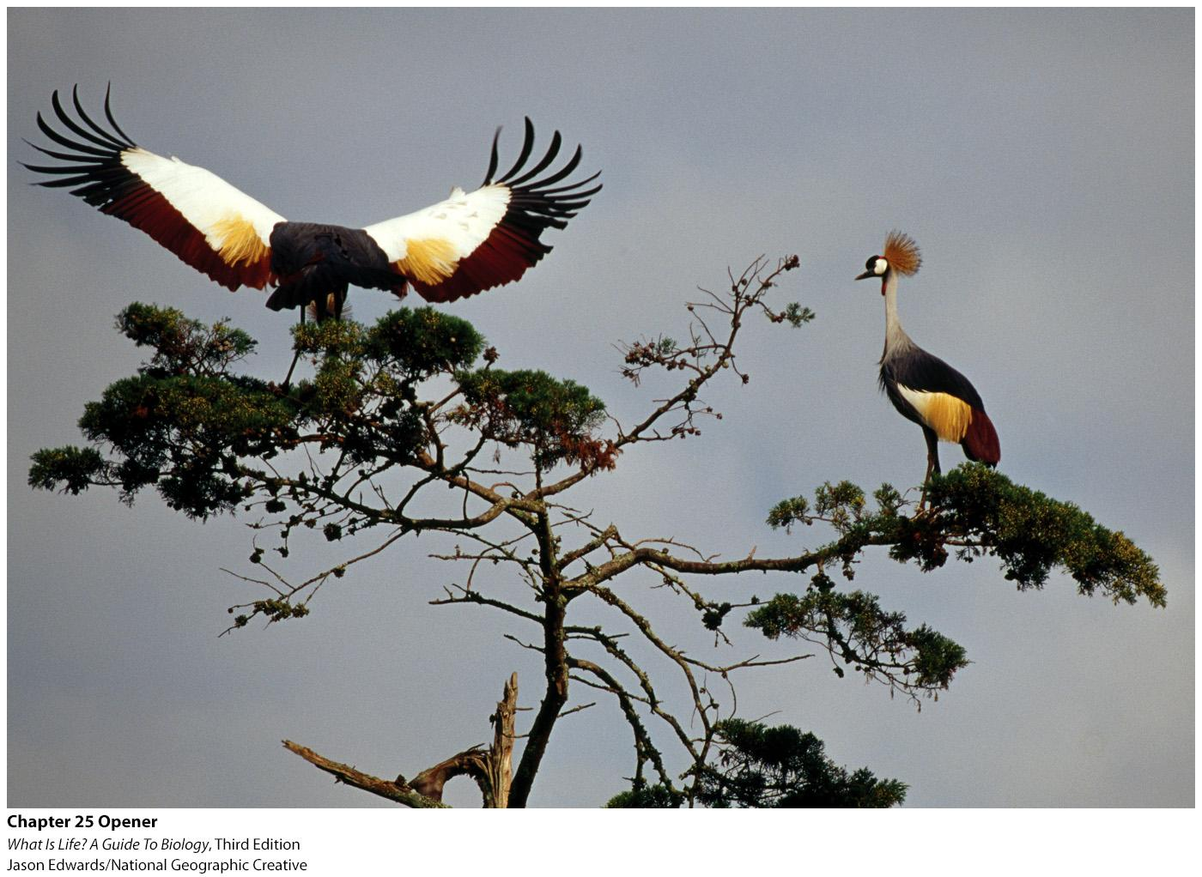
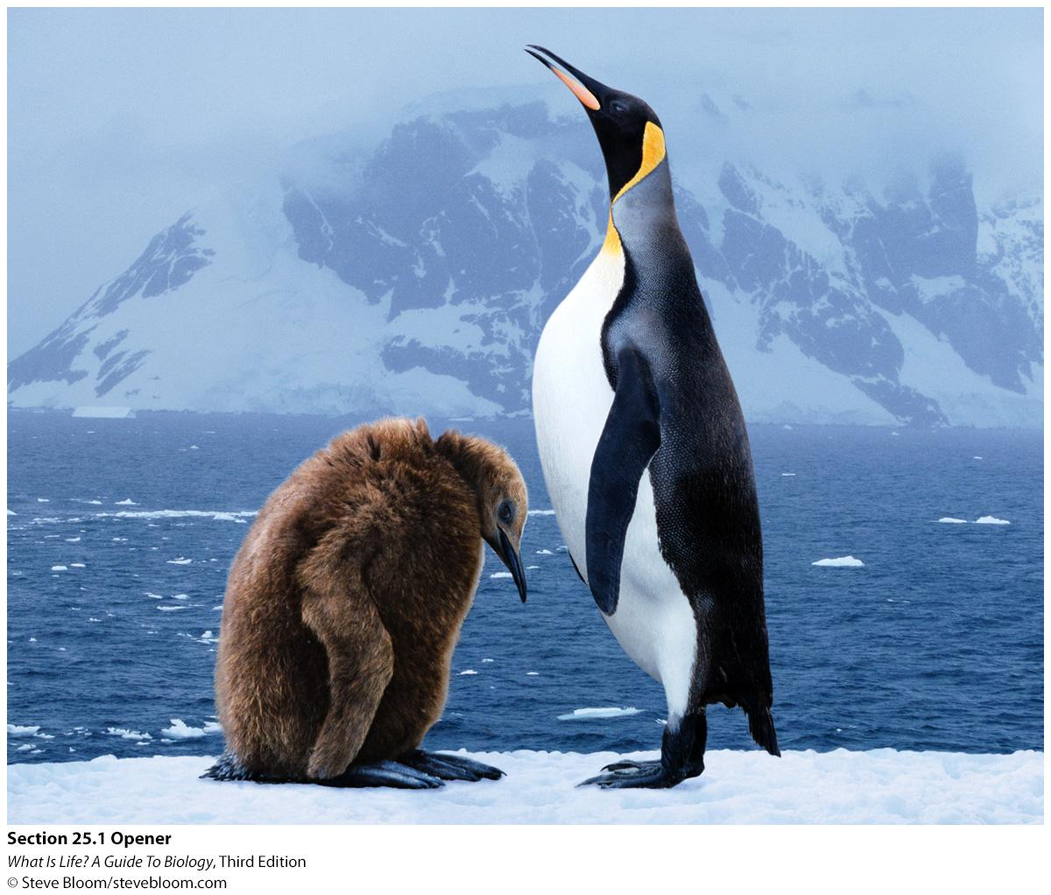


Reproductive System
Dr. ANAND BIO 101 Spring 2017
04/05/2017

Slide 2
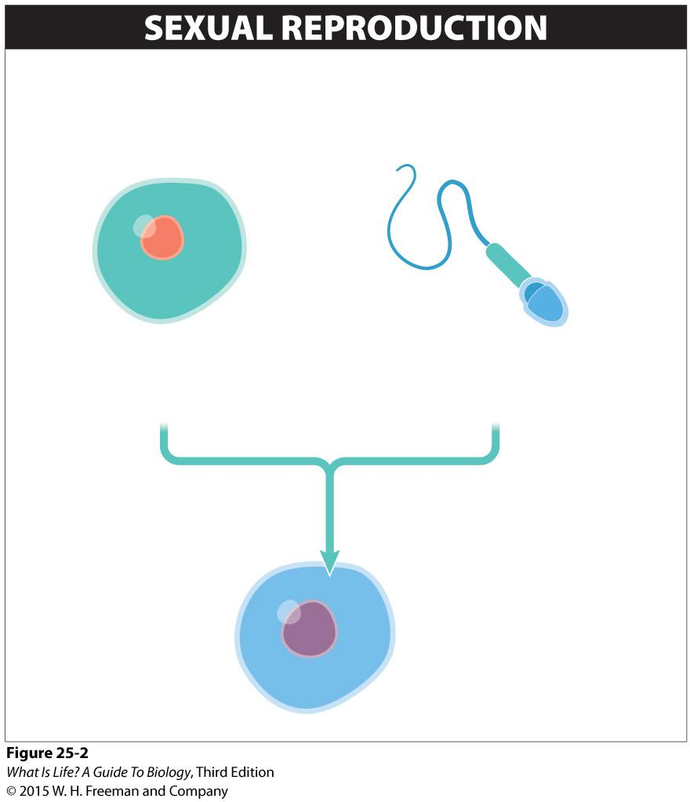
Types of reproduction: Sexual & Asexul
Sexual reproduction involves two individuals contributing genetic material to produce offspring. The genetic material is contained in gametes, the reproductive cells.
EGG
Female gamete
Haploid (one copy of each chromosome)
SPERM
Male gamete
Haploid (one copy of each chromosome)
FERTILIZATION
FERTILIZED EGG (ZYGOTE)
Diploid (two copies of each chromosome)

Slide 3
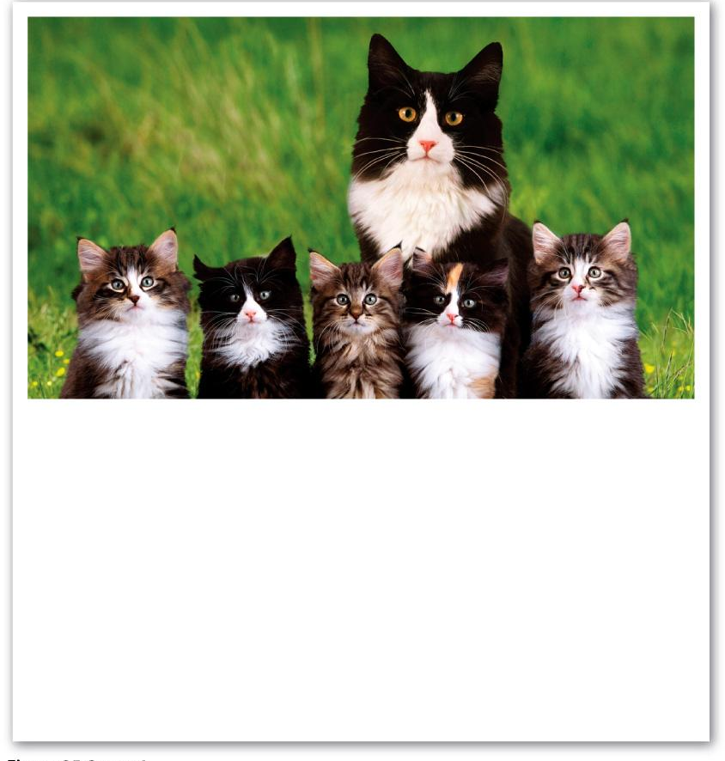
Pros and Cons of Sexual reproduction
SEXUAL REPRODUCTION
ADVANTAGES
Offspring are genetically different from each other and from either parent—an evolutionary adaptation that can lead to increased fitness in changing environments.
DISADVANTAGES
Finding a partner and mating can be difficult and time-consuming.
Only half of an individual’s alleles will be passed to its offspring.

Slide 4
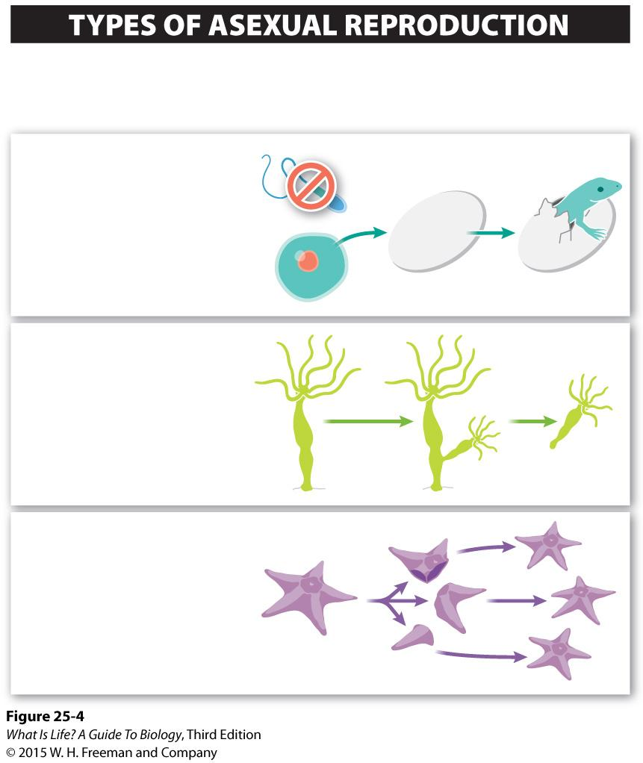
Asexual reproduction involves the production of offspring by a single individual without contribution of genetic material from another individual.
PARTHENOGENESIS
A female’s egg develops into a new organism without ever having to be fertilized by a sperm cell.
BUDDING
An offspring grows right out of the body of the parent.
FRAGMENTATION
A parent breaks into multiple pieces, and each develops into a fully functioning, independent individual.

Slide 5
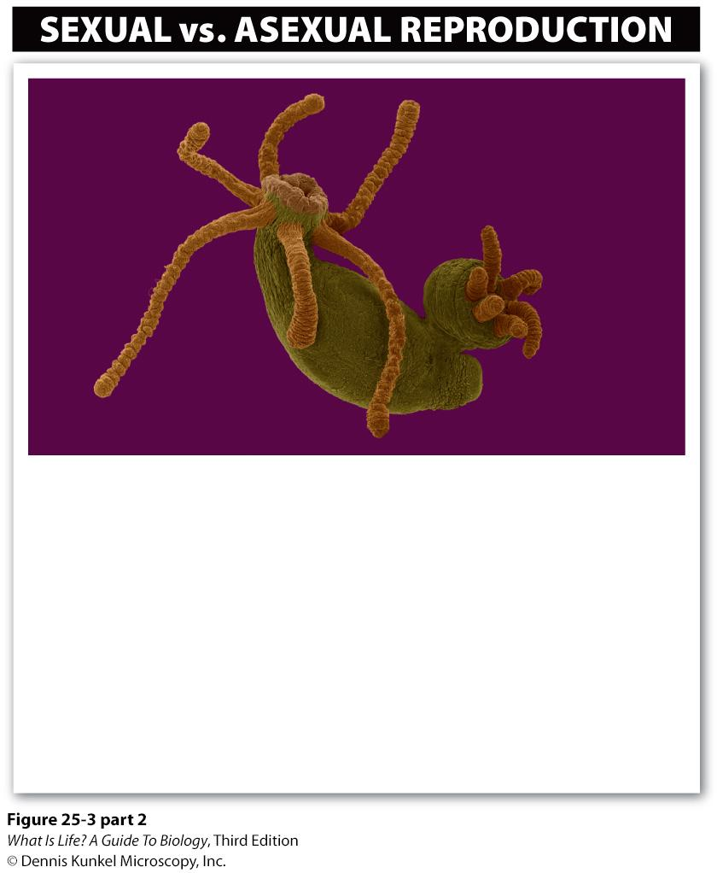
Pros and Cons of Asexual reproduction
One method of asexual reproduction is shown here. A small hydra buds from a parent hydra.
ASEXUAL REPRODUCTION
ADVANTAGES
Reproduction is fast and efficient.
All of an individual’s alleles are passed on to its offspring.
DISADVANTAGES
With a changing environment, individuals producing genetically identical offspring are less likely to have offspring suited to the environment.

Slide 6
Take-home messages
Organisms can reproduce sexually or asexually—or both.
Sexual reproduction, which leads to offspring that are genetically different from each other and from both parents, occurs in the vast majority of plant and animal species.
Asexual reproduction, which can be fast and efficient, leads to offspring genetically identical to the parent; it occurs in all prokaryotes and in many plant and animal species.

Slide 7
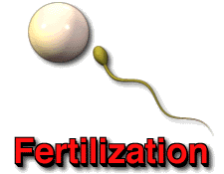
Fertilization, also known as syngamy, is the fusion of two gametes – most familiarly sperm and egg – to form a zygote. Thus two haploid gamete cellstogether form the diploid zygote.

Slide 8
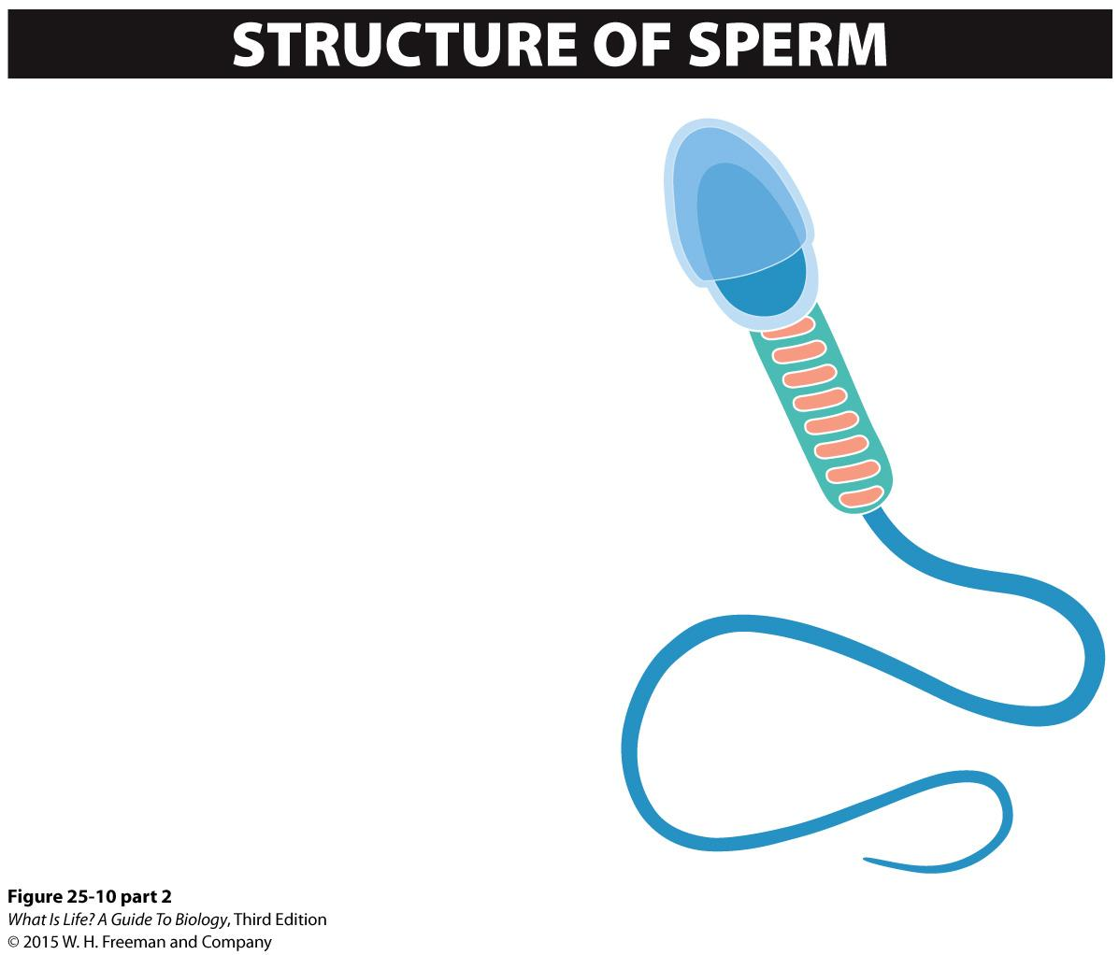
HEAD
Contains the nucleus with DNA and is capped by an acrosome, which aids in breaking down the protective layers surrounding an egg
Acrosome
Nucleus
BODY
Contains many mitochondria, which generate energy
TAIL
A flagellum, which propels the sperm

Slide 9
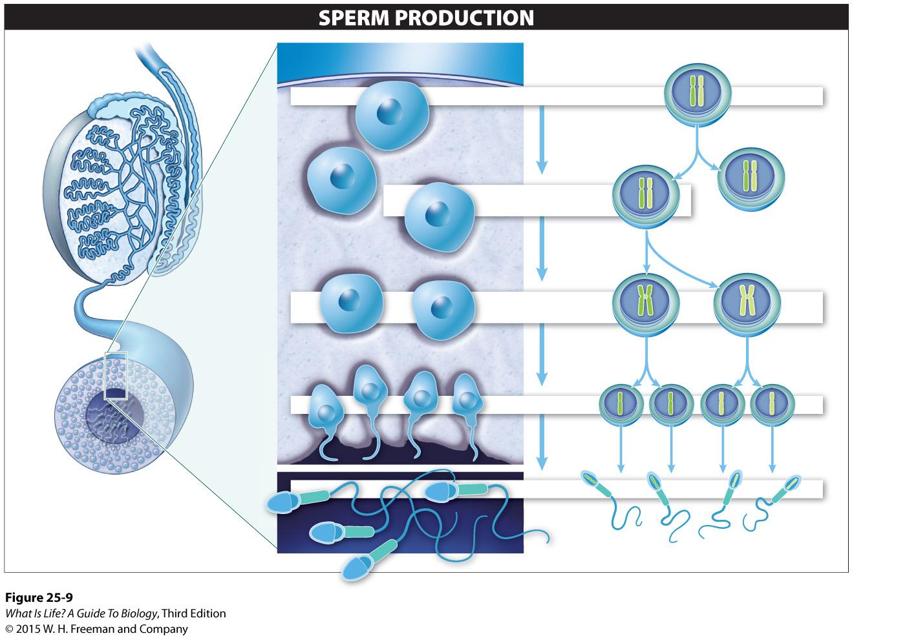
Because one of the cells produced by mitosis is another spermatogonium, the male never runs out of sperm-producing cells.
Testes
Vas deferens
Epididymis
SPERMATOGONIUM
MITOSIS
PRIMARY
SPERMATOCYTE
Spermatogonium
MEIOSIS I - separation of the homologues
SECONDARY
SPERMATOCYTES
Seminiferous
tubule
MEIOSIS II - separation of the sister chromatids
SPERMATIDS
MATURATION
As each spermatid matures into a sperm cell, it moves from the seminiferous tubules to the epididymis.
SPERM

Slide 10
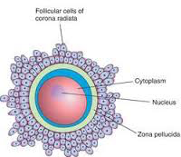
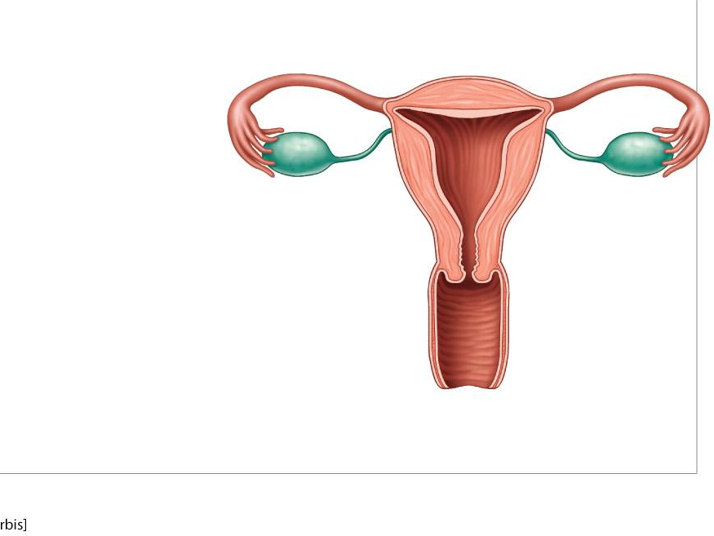
Egg: Produced in Ovaries
Uterus (womb)
Endometrium
Fallopian tube
(oviduct)
Ovary
Cervix
Vagina
Bladder
(excretory system)
Urethra
(excretory system)
Clitoris
Labia
Vaginal opening

Slide 11
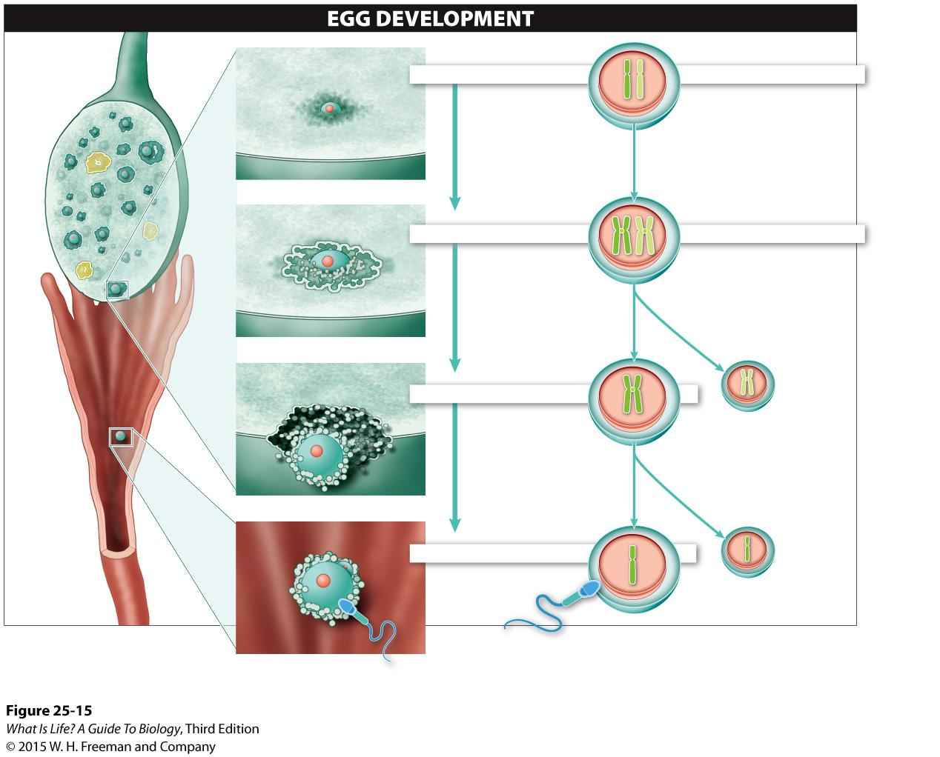
Oogonium
Ovary
OOGONIUM
MEIOSIS I: BEGINS
Meiosis begins in the ovaries prior to birth, but stops at prophase I until puberty.
Primary oocyte
PRIMARY OOCYTE
Follicle
MEIOSIS I: COMPLETE
During puberty, the release of hormones stimulate the completion of meiosis I.
Secondary oocyte
during ovulation
SECONDARY OOCYTE
Polar body
MEIOSIS II: COMPLETE
The completion of meiosis II is triggered only after a secondary oocyte is fertilized.
Fallopian
tube
Ovum
Polar body
OVUM (EGG)
Sperm
Polar body

Slide 12
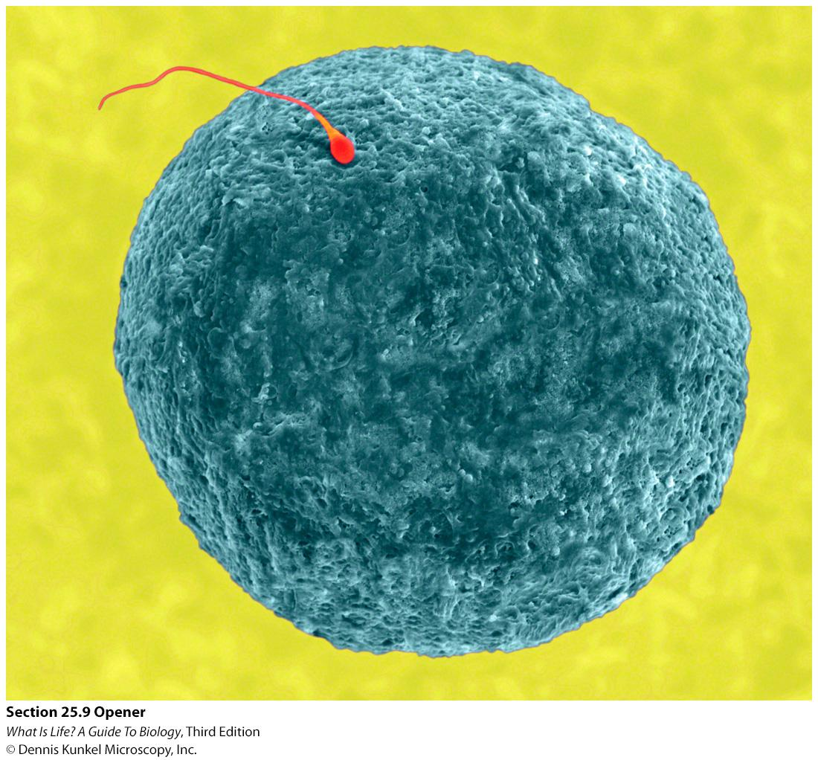

Slide 13
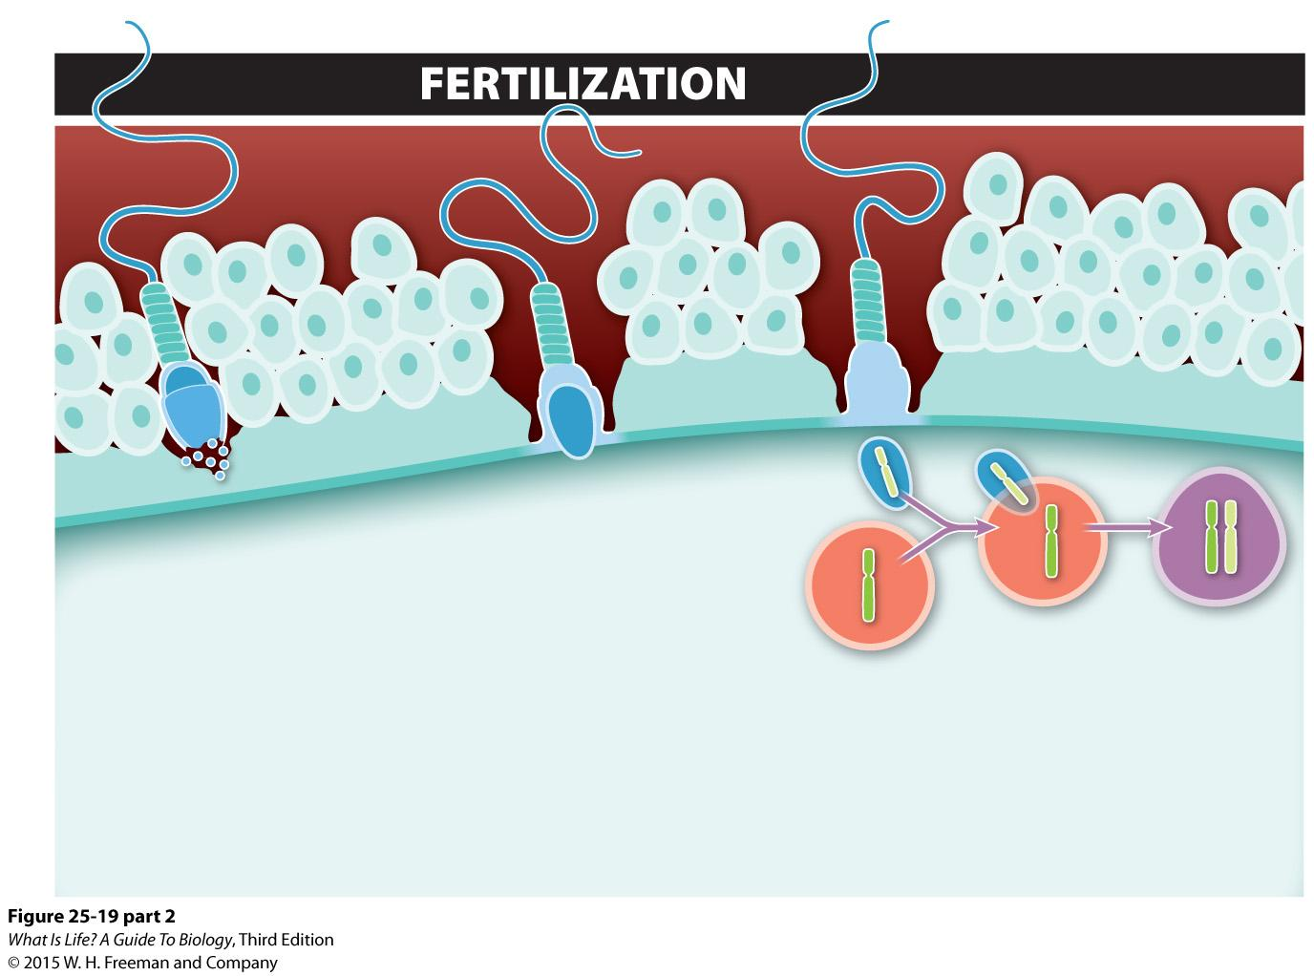
SPERM
Granulosa cells
Zona pellucida
Sperm
nucleus
Plasma
membrane
Enzymes
Acrosome
Egg
nucleus
EGG
Zygote
nucleus
PENETRATION
A sperm pushes its way through the granulosa cells, and enzymes within its acrosome digest the zona pellucida.
ACTIVATION
The plasma membrane of the sperm and egg fuse, making it impossible for other sperm to fuse with the egg.
NUCLEI FUSION
The haploid nucleus of the egg fuses with the haploid nucleus of the sperm, forming a diploid zygote.
1
2
3

Slide 14
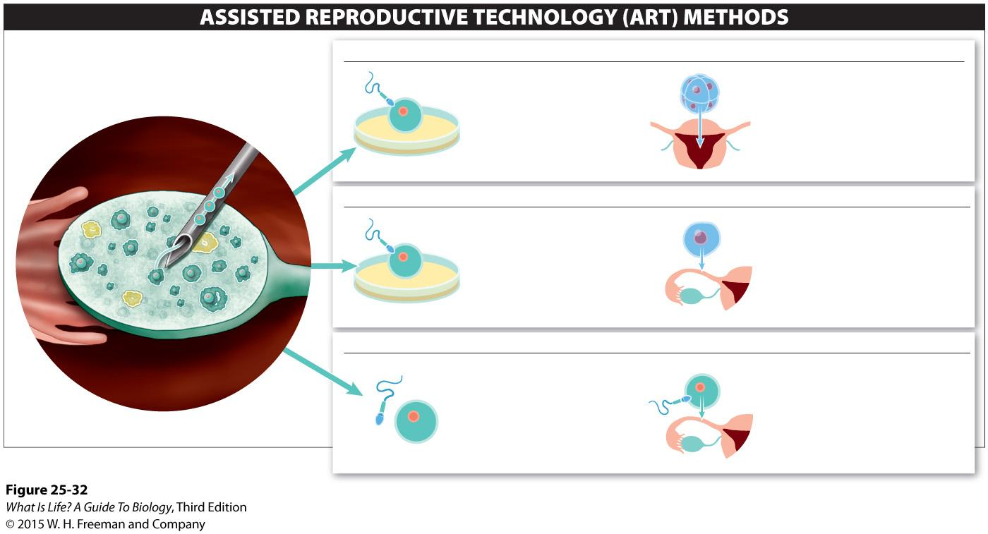
Assisted reproductive technologies can enable previously infertile couples to have babies.
IN VITRO FERTILIZATION–EMBRYO TRANSFER (IVF–ET)
2
The eggs are combined with sperm in a Petri dish, where fertilization occurs.
3
Fertilized eggs at the 8-cell stage are inserted into the uterus.
1
Several eggs (secondary oocytes) are collected from a woman’s ovaries.
ZYGOTE INTRA-FALLOPIAN TUBE TRANSFER (ZIFT)
2
The eggs are combined with sperm in a Petri dish, where fertilization occurs.
3
Fertilized eggs at the 1-cell stage are inserted into the Fallopian tube.
GAMETE INTRA-FALLOPIAN TUBE TRANSFER (GIFT)
2
The eggs are immediately mixed with sperm.
3
The mixture of sperm and eggs is immediately inserted into the Fallopian tube, where fertilization occurs.

Slide 15

Advances in assisted reproductive technology are giving rise to complex legal battles and ethical dilemmas.
Technology is making conception and pregnancy possible in many situations where previously they were not possible.

Slide 16
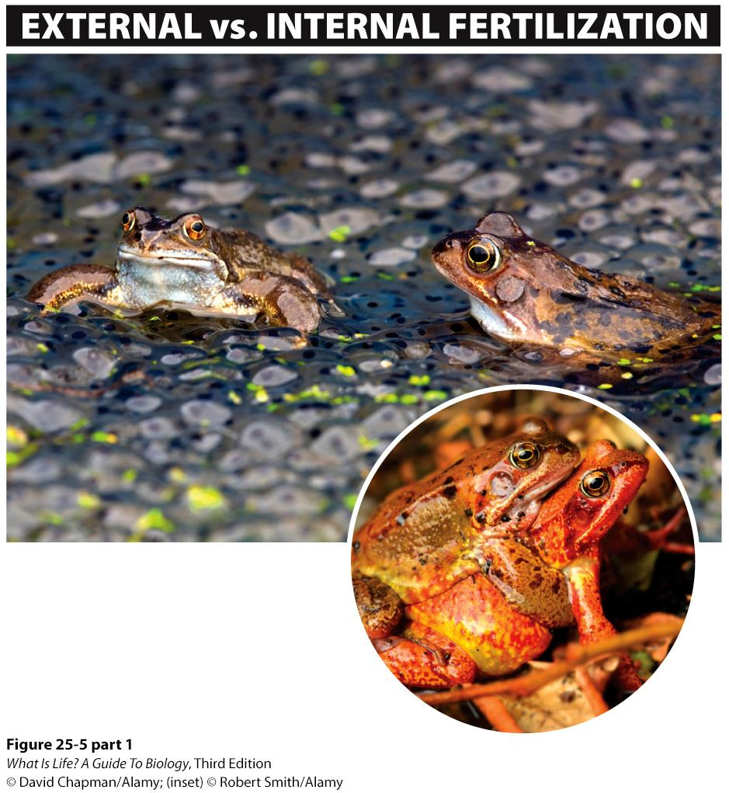
During amplexus, the male frog hangs onto the female until she lays her eggs into the water, at which point he fertilizes them with his sperm.
EXTERNAL FERTILIZATION
The sperm and egg unite outside the male’s and the female’s body.

Slide 17
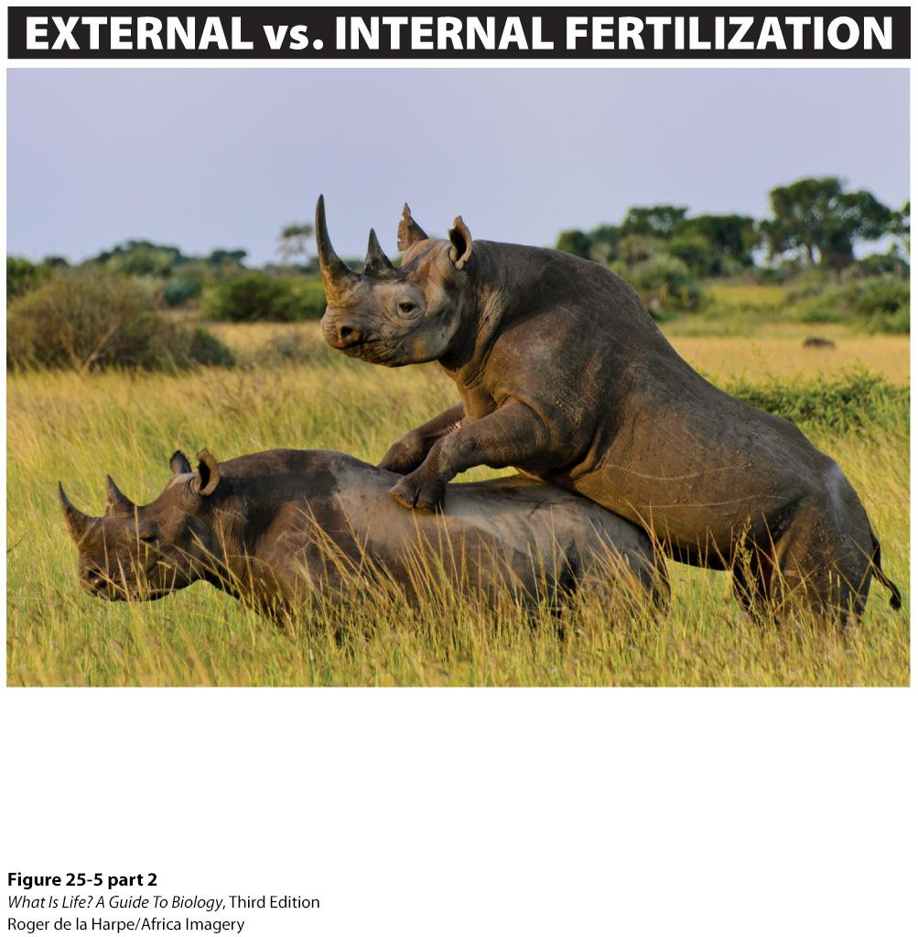
INTERNAL FERTILIZATION
Sperm are deposited directly in the female’s reproductive tract and unite with eggs inside the female’s body.

Slide 18
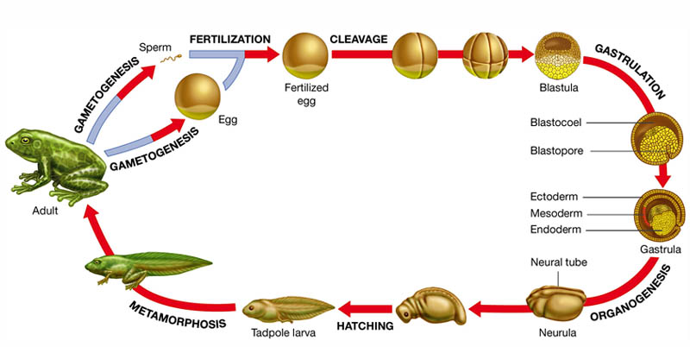
Embryonic development
Fertilized Egg is called Zygote: divides/develops to the organism

Slide 19
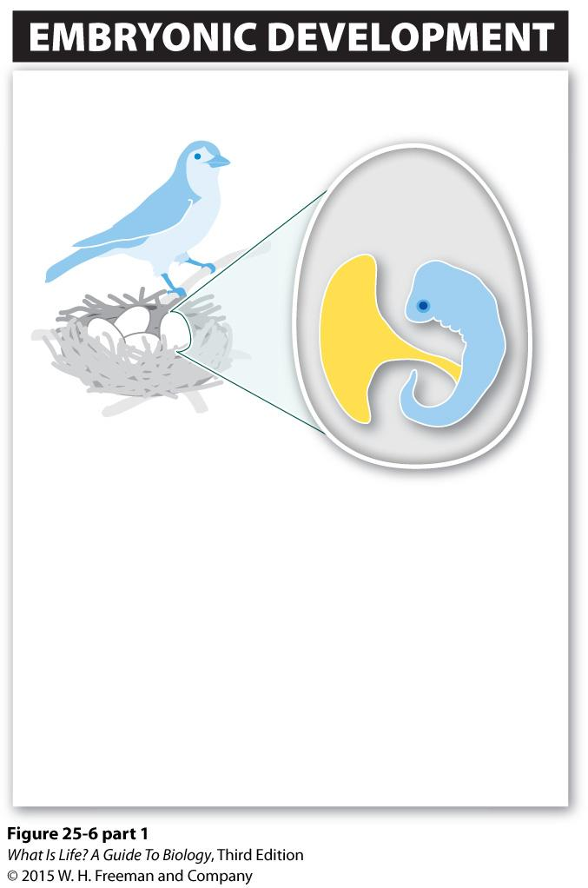
Egg
Yolk
Embryo
OVIPARITY
Most embryonic development takes place within an egg outside the mother’s body
Embryo is nourished by nutrients in the egg’s yolk
Examples: all birds; also some fishes, amphibians, reptiles, insects, and spiders

Slide 20
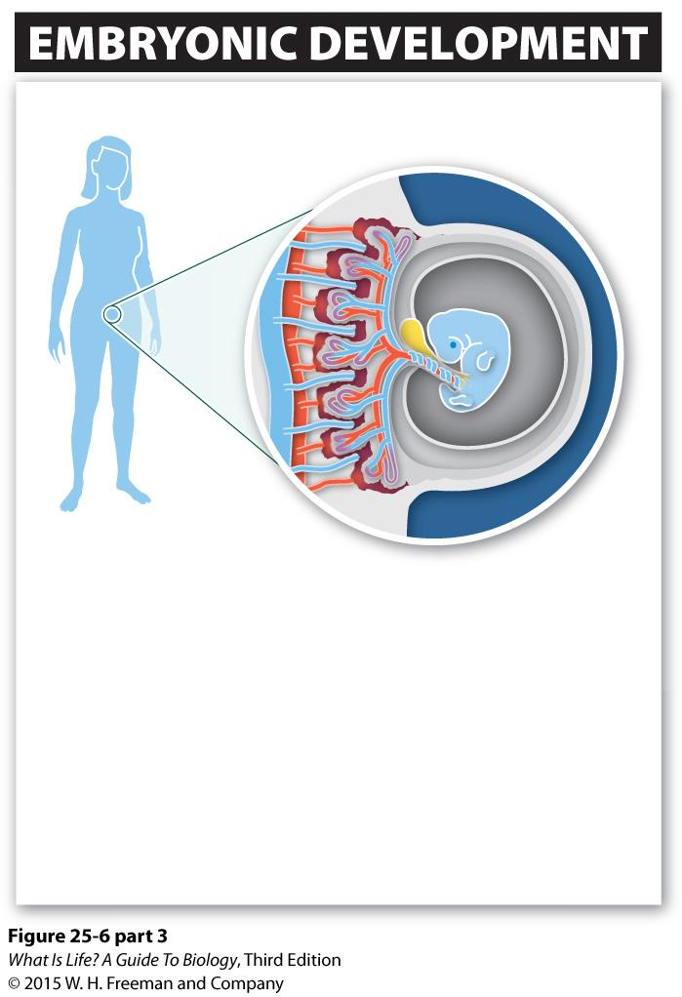
Mother’s blood vessels
Embryo
VIVIPARITY
Most embryonic development takes place inside the mother, and live offspring are born
Embryo is nourished by nutrients in the mother’s blood
Examples: nearly all mammals; also some fishes, amphibians, and reptiles

Slide 21
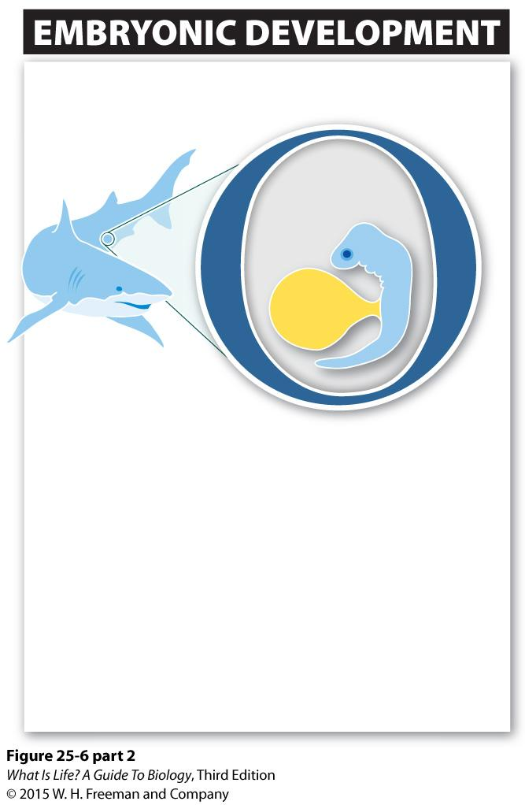
Egg
Embryo
Yolk
OVOVIVIPARITY
Most embryonic development takes place within an egg that remains in the mother’s body until it hatches (or is released just before hatching)
Embryo is nourished by nutrients in the egg’s yolk
Examples: some sharks and other fishes, amphibians, reptiles, and invertebrates

Slide 22
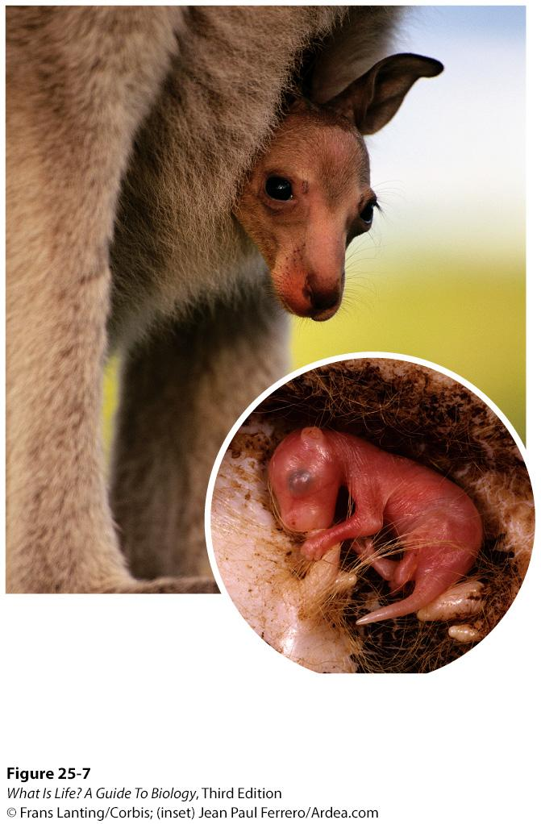
Kangaroo offspring emerge from the womb after about 33 days, blind, hairless, and just a few centimeters long. They continue developing (for many months) in the mother’s protective pouch.

Slide 23
How does an embryo become male or female?

Slide 24
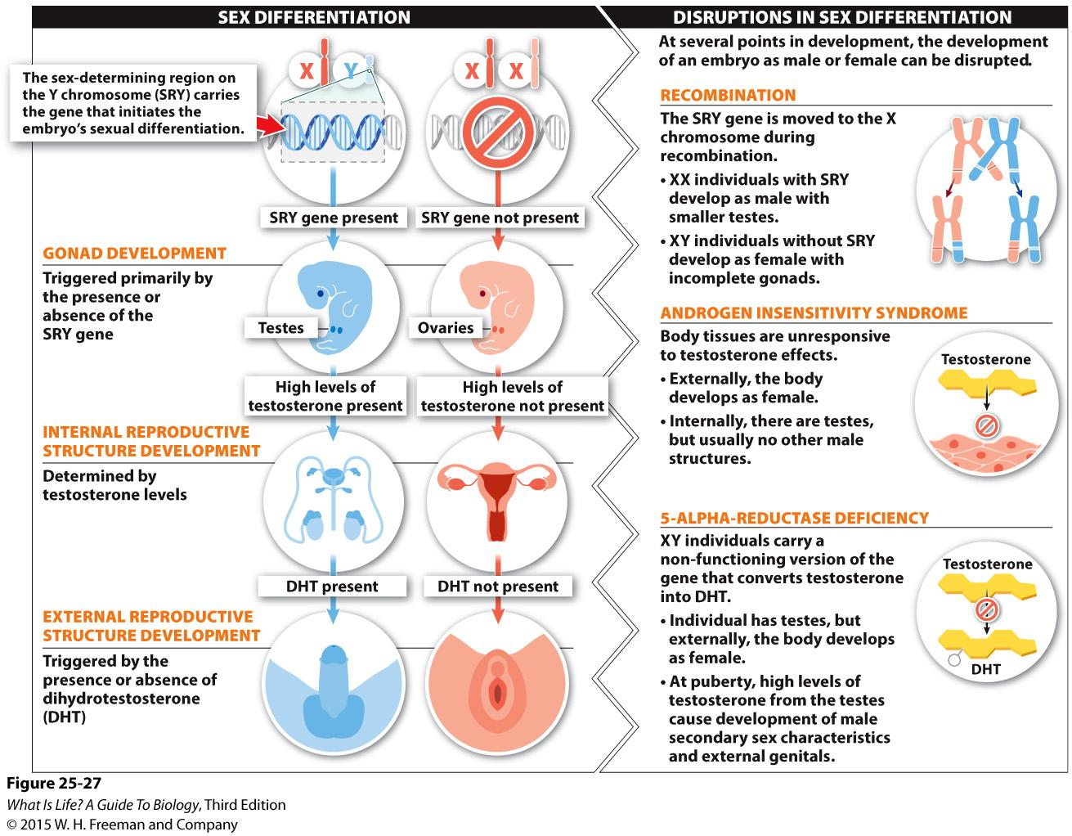
Notes:
Mammalian embryos develop female internal and external reproductive organs unless a gene on the Y chromosome stimulates fetal gonads to develop as testes, leading to testosterone production, which then stimulates the development of male reproductive organs.
During the first few weeks after fertilization, surprisingly little distinguishes males from females. Then, about four weeks into embryo development in mammals, a gene carried on the Y chromosome, called SRY (for sex-determining region on the Y chromosome), can initiate development as a male. The gene is expressed in the tissue that will form the gonads, and usually, when SRY is expressed, the gonads develop as testes. (There is a gene on the X chromosome that also influences sex determination and, in rare cases, can alter typical sex development.) If SRY is not present, ovaries develop instead

Slide 25
Sexually transmitted diseases reveal battles between microbes and humans.
more than 300 million new cases of STDs occur each year.

Slide 26
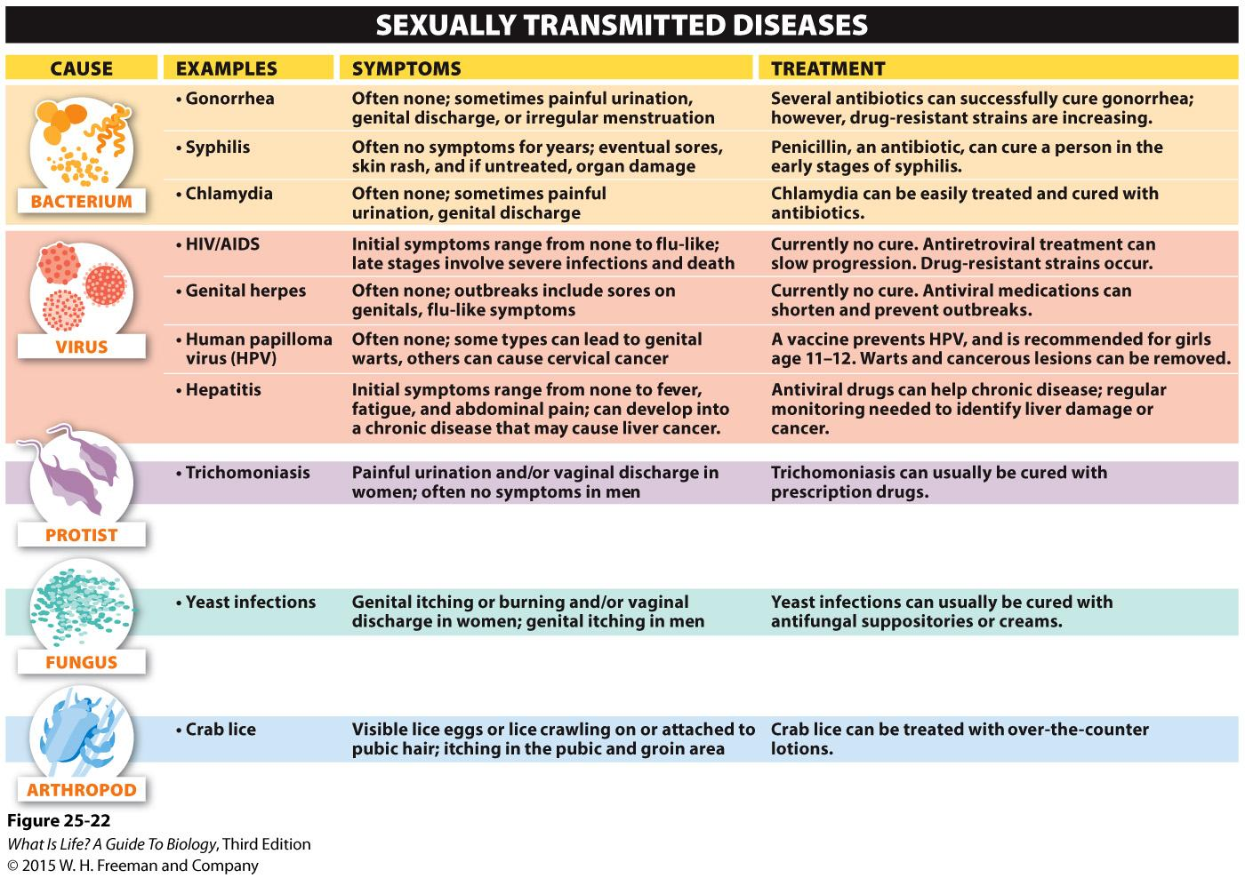

Slide 27
How is the knowledge about reproductive system
helpful in your life?
Write at least 3 points
Submit while you walkout
Remember to write your Name and ID

